Slide 1
CT EEB X1931-2
Coincidence Factor and Commercial Loadshape Research
Mike Frischmann, EcoMetric
3/8/2021
Notes:
Introduce that we combined 2A and 2B. KAR will intro.
Hello everyone,. My name is Mike Frischmann, and I’m a Principal at EcoMetric. We’ve been helping ERS with X1931 over the last year. Thanks for giving me the opportunity to present our proposed scope and overview of the coincidence factor and loadshape research for Phase 3 of this effort.

Slide 2



Agenda
2
Background and Objectives
Approach
Detailed Tasks
Schedule
Budget
Notes:
The agenda we will cover today is very similar to what you have seen for other research tasks. We’ll walk through a bit of background and what our overall objectives are. I’ll talk through our approach for how we want to achieve those objectives. Then I’ll talk through the detailed tasks, and finish up with a schedule and budget discussion.

Slide 3
Peak Coincidence Factor (CF) and Peak Definition
Peak Coincident Demand. The amount of capacity (kW) savings that occur during a defined period in time. This is estimated with a parameter called coincidence factor (CF).
Energy efficiency measures reduce overall energy consumption (kWh) and system peak capacity requirements.
  Lighting
  HVAC
  Controls
  Custom
  domestic hot water
  appliances
Different ISO-NE Definitions
  On Peak: 1:00pm – 5:00pm, non-holiday weekdays during June, July, and August; 5:00pm – 7:00pm, non-holiday weekdays during December and January.
  Seasonal Peak: when real load exceeds 90% of the 50/50 load forecast for non-holiday weekdays during June, July, August, December, and January.
The utility companies use Seasonal Peak. PSD factors should also use that definition.
This study will focus on peak electric factors, only.
Notes:
I want to start with some specific background and information about peak demand, and coincidence factors.
CF is the ratio of demand that occurs during the specific window to total demand savings for a measure.

Slide 4
Peak Coincidence Factors in the PSD
Appendix One: Peak Factors – Summarizes CF for ISO-NE Seasonal Peak Demand Reductions
  Provides coincidence factors for 27 of the 72 measures (Res and C&I) in the PSD.
  Remaining referenced within the measure chapters.
Approximately three quarters of CFs utilize sources from 2007
The referenced sources show 55% of CFs correspond to the ISO-NE seasonal peak
Others refer to on-peak or system peak definitions.

Slide 5
Seasonal Peak in the PSD
The companies use the ISO-NE seasonal peak definition for resource claims. Seasonal peak is when the actual load exceeds the ISO-NE 50/50 load forecast.
Seasonal peaks have shifted significantly over time and vary notably year over year.*
*As referenced in DNV Memo, CT Seasonal Peak Summary (provided April 2020).

Slide 6
Seasonal Peak in the PSD
Commercial Unitary AC, Heat Pumps, and C&I Refrigeration measure categories produced significant savings in 2019.
HVAC measure demand impacts are affected by shifting seasonal peaks.
C&I Loadshapes from Appendix Two: Table A2-1
End Use | Winter Peak Energy % | Winter Off-Peak Energy % | Summer Peak Energy % | Summer Off-Peak Energy %
Cooling (Large C&I) | 17% | 12% | 42% | 29%
Cooling (Small C&I) | 20% | 12% | 40% | 28%
Heating | 55% | 27% | 12% | 6%
Refrigeration | 30% | 37% | 15% | 18%
Notes:
Two reasons we are focusing on lighting, the focus on the shift away from lighting, and the MA data we have is less granular.
make sure we say that we are combining the loadshape and CF data.
drive home the time of day and day of the year variability as a key reason.

Slide 7
Part 1 Study Objectives – Appendix One CF
Comprehensive compilation of Appendix One¹ to include of all CF values.
  Res and C&I measures
  Include all values not currently located in the appendix.
  Validating and documenting if seasonal peak is used for all CF values.
  1. Table A-1, A-2, and A-3
Notes:
Now the reader has one place to go to find all of the information. We’ll make an update if possible, but that’s not the key purpose. No new research.
Talking point. we are not determining new values for these, but instead making the appendix cleaner and more valuable.

Slide 8
Part 2 Study Objectives – Refresh Seasonal Peak
Update CF values through primary research
  Leverage MA PA C&I Loadshape Tool, MA Residential Baseline Data
    C&I Loadshape Tool
      628 individual project savings loadshapes
      Compressed Air, Chillers,
      Compiled into filterable spreadsheet
    Residential Baseline Data
      25 end uses at 350 homes
      HVAC, Water Heating, Kitchen, Laundry, Lighting, Misc
      Spreadsheets with compiled average loadshapes
  Supplement with project data from recent CT studies (e.g., C1634, C1635, DNV Peak Memo).
  Using 2019 ensures a complete year of data and avoids potential COVID implications from 2020 seasonal data.
Notes:
Discuss why we are focusing on these – because there is significant overlap between updating the CFs and developing the loadshapes. Make sure to mention the naming of the loadshapes and how its different than the measure names.

Slide 9
Part 2 Study Objectives – Refresh Seasonal Peak
Update CF values through primary research
  Revise CFs and load shapes for key end-uses:
    Small C&I Cooling
    Large C&I Cooling
    C&I Variable Frequency Drives
    C&I Refrigeration
    Res Central AC
    Res Window AC
    Res Ductless Heat Pump
    Res Heating
    Res Refrigeration
    Res Water heating
Notes:
Discuss why we are focusing on these – because there is significant overlap between updating the CFs and developing the loadshapes. Make sure to mention the naming of the loadshapes and how its different than the measure names.

Slide 10
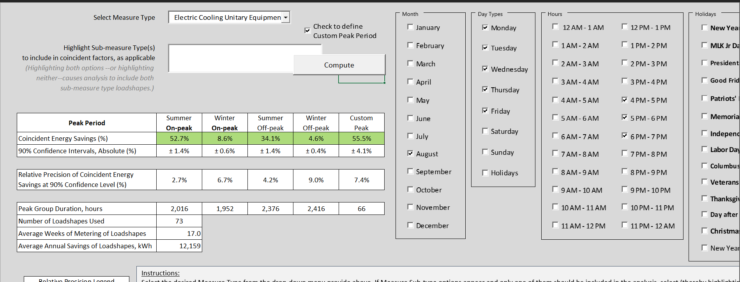
Part 2 Study Objectives – Refresh Seasonal Peak
Integrate data into the MA loadshape tool that can be used going forward to update C&I CFs as peak periods change.
  Provides flexibility to adapt to changing ISO-NE seasonal peak periods.
Notes:
Discuss why we are focusing on these – because there is significant overlap between updating the CFs and developing the loadshapes. Make sure to mention the naming of the loadshapes and how its different than the measure names.

Slide 11
Summary of Approach
Leverage existing research and data:
  Primary Research: Leverage substantial MA data and supplemental CT data
    Deliver interactive C&I load shape tool that allows peak period revision in the future.
  Literature Review and Secondary Research: Review existing references and documents cited in PSD.
    Transparently document references and peak definitions for all measure categories.
Notes:
2016 MA market characterization study and others

Slide 12
Tasks and Methodology
Task 1: Data Request and Literature Review
  Evaluation and research consultants – Use primary data from C1634 and C1635
    Project-level workbooks
    Program-level demand analyses
    Raw metered data or trends
    Other data streams or sources specific to C&I research or evaluation studies.
Task 2: Secondary Research – Consolidate Appendix One
  Edit Appendix One to address all measure CFs
    Add definition of peak period used
    Ensure links to references are working whenever possible

Slide 13
Tasks and Methodology (cont.)
Task 3: Primary Research - Data Cleaning and Processing
  Categorize and organize project level data
  Reformat for consistency across projects, measures, and time periods
  Clean outliers and missing time series data
  Normalize and regularize data to consistent scales across projects

Slide 14
Tasks and Methodology (cont.)
Task 4: Primary Research - Data Analysis
  Transform and append metered data into existing MA C&I tool.
  Compile MA residential data into annual, hourly loadshapes
  Determine updated coincidence factors in the PSD based on recent (2019) ISO-NE seasonal peak conditions.

Slide 15
Tasks and Methodology (cont.)
Task 5: Final Deliverables
  Deliver expanded Appendix One including all C&I measures, references, and peak definitions
  Deliver updated CFs for selected end-uses during June 2021, in time for the next PSD update.
  Deliver C&I loadshape tool.
  Draft and final summary reports.
  Final presentation to stakeholders summarizing methods, updated CFs, and new loadshapes.

Slide 16
Study Objectives and Outcomes
Objective | Method | Outcome
Include all CF values for C&I and Res measures in Appendix One of PSD, indicate the definition of peak used, provide documented references for each value (when possible). | Secondary literature review Organization of existing PSD values and information | An updated Appendix One that comprehensively shows all Res and C&I measure CFs, the referenced peak definition, and the source.
Confirm or update existing CF values using 2019 seasonal peak hours, MA loadshape data, and supplemental data mined from prior CT C&I evaluations. Unitary AC Heat Pumps VFDs Refrigeration | Leverage large MA primary data sets Supplement with existing primary research in CT Data analysis to merge into one dataset. | Updated CFs in Appendix One and corresponding PSD measures Spreadsheet which provides annual loadshape and CF based on defined seasonal peak.
Revise load shapes with data mined from prior C&I evaluations and research studies. Small C&I Cooling, Large C&I Cooling C&I Refrigeration C&I VFDs Res Heating, Cooling, Refrigeration, Water Heating | Leverage large MA primary data sets Supplement with existing primary research in CT Data analysis to merge into one dataset. | C&I Loadshape tool that can be used going forward to update CFs as peak periods change. Update the loadshapes in Appendix Two.

Slide 17
Schedule and Budget
Kickoff: March 2021
Data Request Returned: complete by March 2021*
Secondary Research – Appendix One CF: April 2021 – deliverable complete for June PSD
Primary Research and Data Analysis – Loadshapes: complete by May 2021
Draft/Final Deliverables and Presentation: June – July 2021*
*This schedule requires a sufficient amount and timely delivery of requested primary data. Additional data request time needs, or partial data availability will require scope refinements which will need additional study time.

Slide 18
Thank You
18

Slide 19

Mike Frischmann, P.E., Principal
mike@ecometricconsulting.com
608.799.8266
ERS is an energy and engineering consulting firm providing services in energy efficiency customer engagement, implementation, evaluation, both pre- and post-installation M&V, custom feasibility studies, and distributed and renewable generation assessment.

